Slide 1


Project proposal Meet-1
Nitya Innovations LLP
Problem Statement:- Driver’s driving pattern detector using inputs
Student Names | Contact information
Janhavi Adhau | janhavi.22010552@viit.ac.in
Deep Jadhav | deep.22010818@viit.ac.in
Rashi Waghmare | rashi.22010685@viit.ac.in
Industry Sponsored by:-Technology Nitya Innovations, LLP9769353315
Guided by – DR. Smita Bhagwat
BRACT’S, Vishwakarma Institute of Information Technology, Pune-48
(An Autonomous Institute affiliated to Savitribai Phule Pune University) (NBA and NAAC accredited, ISO 9001:2015 certified)

Slide 2
Project Survey
[1] N.Kapoor, et al., “Using mobile phone sensors to detect driving behavior”, Proceedings of the 3rd ACM Symposium on Computingfor Development , 2013.
This application collects data from accelerometers, GPS and also record sounds with the help of microphone, and then data is combined and analyzed to detect rash driving patterns.
[2] Fazeen M. ,et al., “Safe Driving Using Mobile Phones”, IEEE Transactions on Intelligent Transportation Systems, 2012.
They have used the three-axis accelerometer of an Android-based smartphone to record and analyze various driver behaviours and external road conditions that could potentially be hazardous to the health of the driver. They have utilized x-axis and y-axis accelerometer
[3] Chigurupa S.,et al., “Integrated Computing System for measuring Driver Safety Index”, International Journal of Emerging Technology and Advanced Engineering,2012
developed an android application which uses data from accelerometer sensor, GPS sensor and video recording is done with the help of camera to give rating to the driver. Whenever the accelerometer values exceed the safe limits it would be considered as an event.
[4] Johnson D.A.,et al., “Driving Style Recognition using a smartphone as a sensor platform” ,IEEE 14th International Conference on Intelligent Transportation system, 2011
They collect data from various sensors (accelerometer, gyroscope, magnetometer, GPS, video) and fused related data into a single classifier based on Dynamic Time Warping (DTW) algorithm. Their system is known as MIROAD: A Mobile-Sensor-Platform for Intelligent Recognition of Aggressive Driving,
The system can provide audible feedback if a driver’s style becomes aggressive as well as the information leading up to an aggressive event

Slide 3
Objective
It can analyze various inputs such as vehicle speed, acceleration, steering behavior, and other driving-related data to accurately detect and classify a driver's driving pattern.
This could include identifying aggressive driving, distracted driving, smooth driving, and other driving behaviors.
By leveraging machine learning algorithms, the project aims to enhance driver safety, provide insights into driving behavior, and potentially contribute to the development of driver assistance systems or driver monitoring technologies.

Slide 4
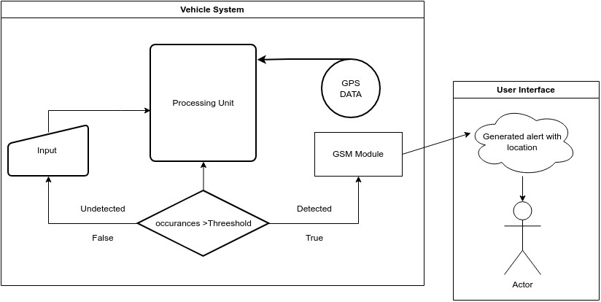
Work Flow Diagram

Slide 5
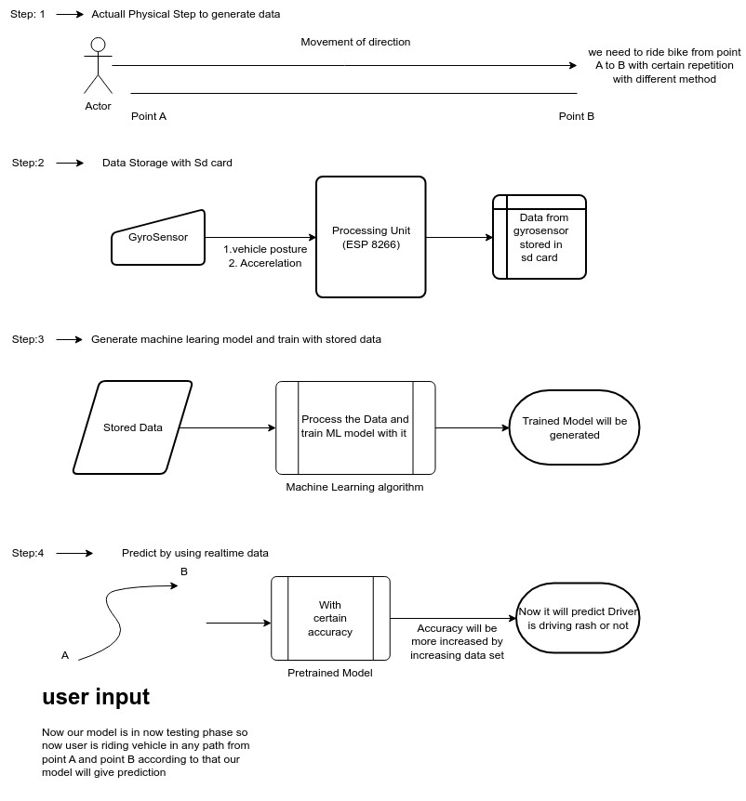

Slide 6
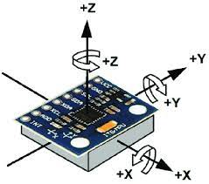
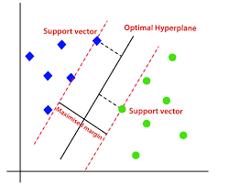
Algorithms
Analyzing axial movements with a speed –
Components required
ESP-8266
MPU6500
GPS NEO-7M
SIM800L V2.0 5V Wireless GSM
Support Vector Machine (SVM)
Features
both classification and regression tasks.

Slide 7
Execution of Project.
Initiation
Understanding the title of the project.
Initial research (sensor research) with project scope. (cost estimation)
Planning
Create a particular plan for the execution of the project.
Phase 1 dates – (1st sept to 7th sept) & Phase 2 dates – (7th sept to 9th oct)
Date – 25th Aug – 2nd Sept.
Required purchasing for the project and set goals.(Phase 1)
Execution of goals and determine the end results. (Phase 2)
Execution
Create tasks and assign them to team (programming, hardware connection/implementation, research and literature survey.)
Start work and Set timelines for the completion of tasks.
Schedule changes accordingly. (designing)
Reach the end goal of the project. ( Dates – 20th Oct)
closure
Evaluate the results.
Check the quality of the product. ( Dates- 5th Nov)
Deliver them.

